Slide 1


Secure FCI Using Partially Homomorphic and Order Revealing Encryption
Marko Ristic – CDC 2020

Slide 2

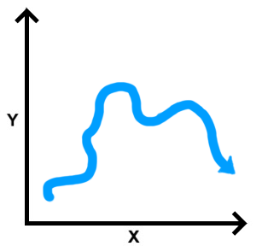



Context
Prevalence of distributed state estimation
State estimate or measurement fusion is typically centrally computed
Untrusted cloud operators and eavesdroppers are a concern

Slide 3

Problem
We consider sensors running local estimation filters
Central fusion of state estimates is computed by an untrusted party
Resulting estimate is encrypted and can be queried by the key holding party
Estimate 1
Estimate 2
Fusion
Estimate n

Slide 4
Related Methods
Fully homomorphic encryption suitable for untrusted cloud computation but slow for real-time systems
Existing methods typically fuse measurements only
Model(s) need to be known by the fuser
No general purpose homomorphic estimate fusion algorithm

Slide 5


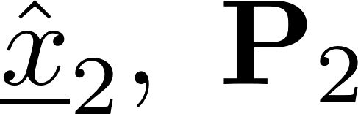
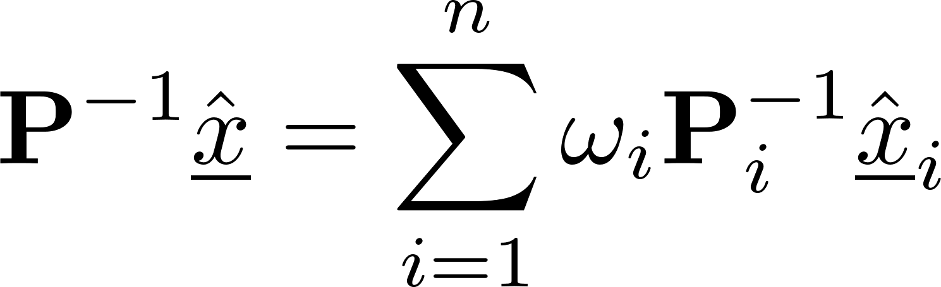
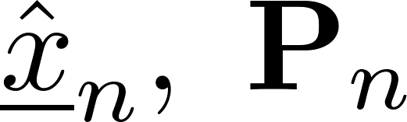
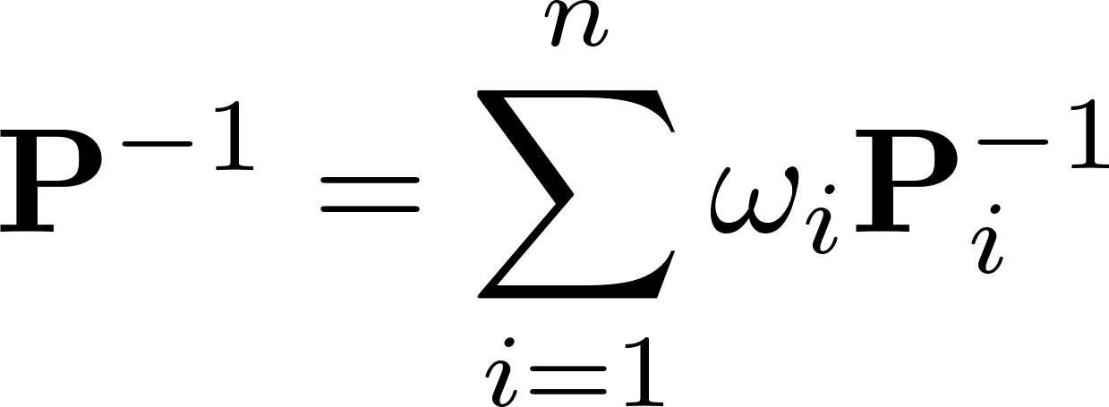
Method Overview
Conservative fusion method without cross-covariance knowledge (CI)
Weights chosen to minimise some property

Slide 6
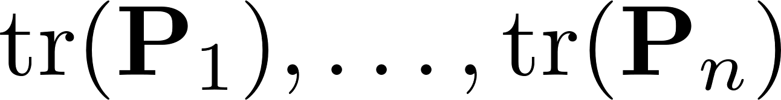
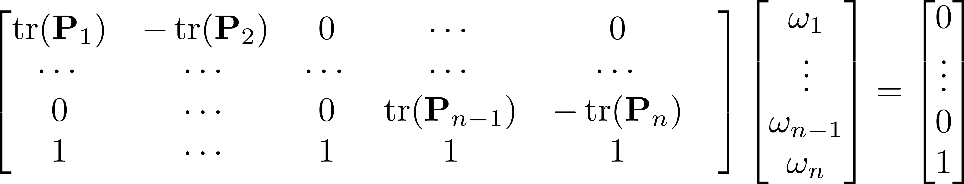
Fast Covariance Intersection (FCI)
Method of computing weights relative to estimate covariance traces
Avoids expensive non-linear minimisation by approximation
Given
Solve

Slide 7
Desired Homomorphic Encryption Schemes
One scheme to compute FCI weights homomorphically. i.e. solve
One scheme to compute fusion homomorphically. i.e. compute
and

Slide 8
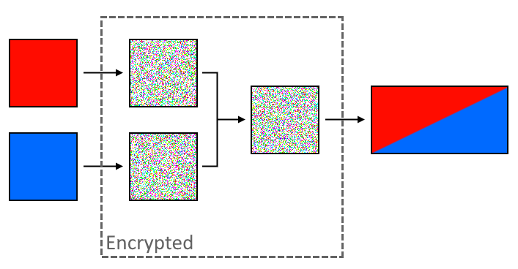
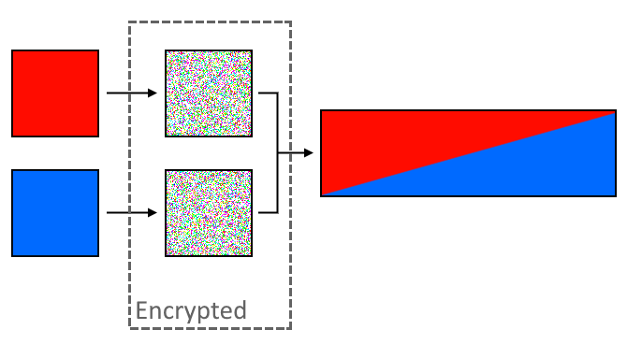

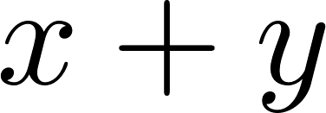
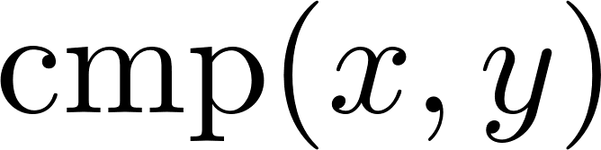

Encryption Schemes
Additive Partially Homomorphic Encryption (PHE) [public key]
Supports scalar multiplication
Can encode real numbers to suit operations
Order-revealing encryption (ORE) [private key]
Can choose comparable values
Can make encryptions from different times incompatible

Slide 9

Two-sensor Case
Use PHE to solve FCI fusion equations
Need to compute weights by solving
Discretise weighted traces and encrypt with ORE
and
such that

Slide 10
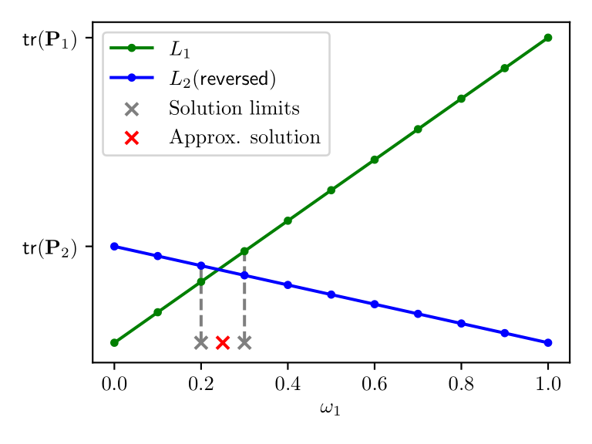
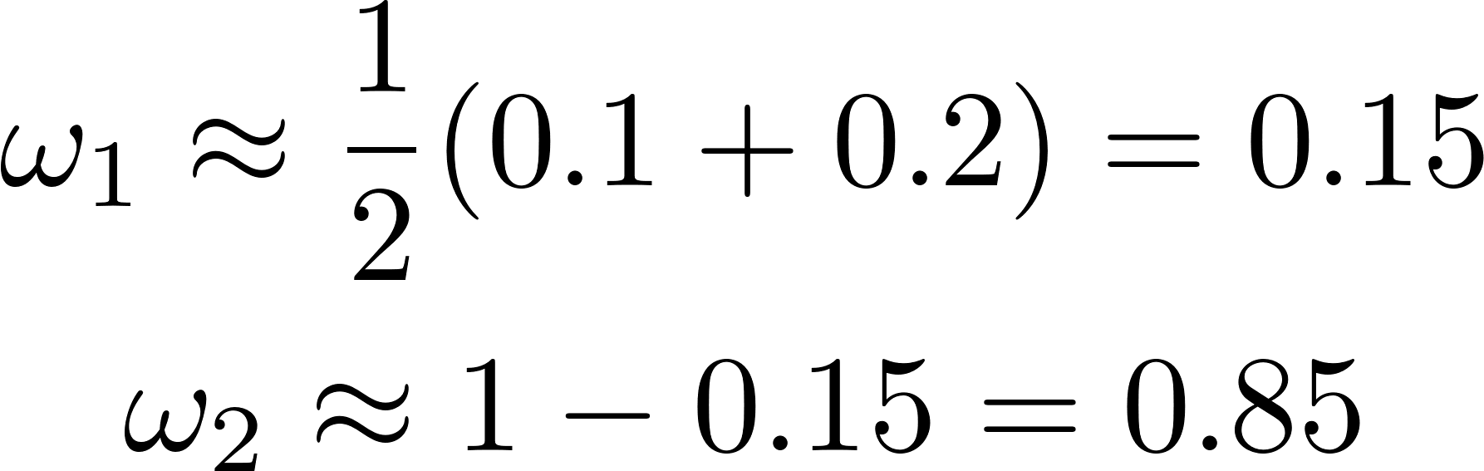
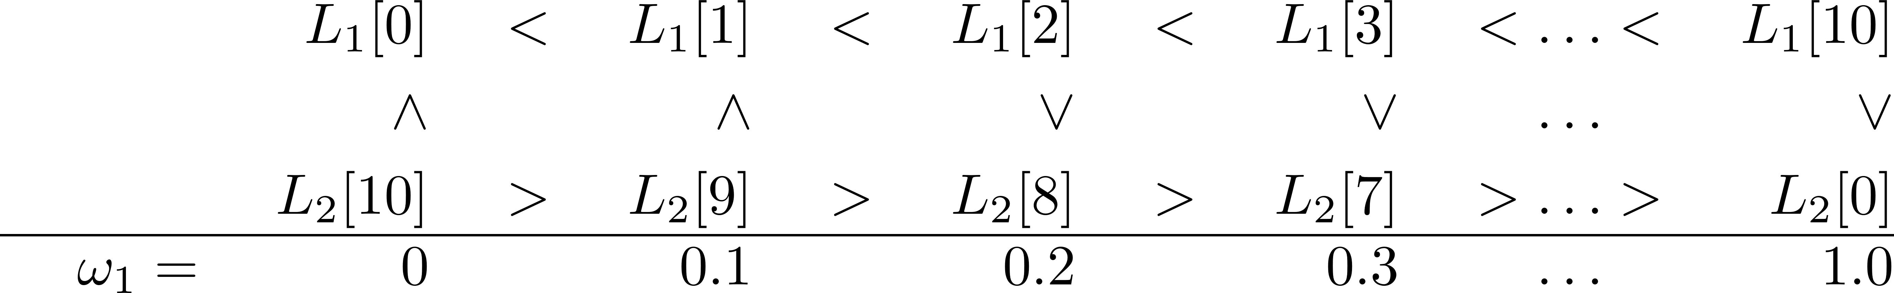

Two-sensor Case
Reversing and intercepting gives weight estimate. Example:

Slide 11
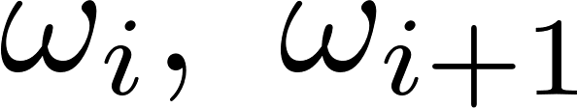
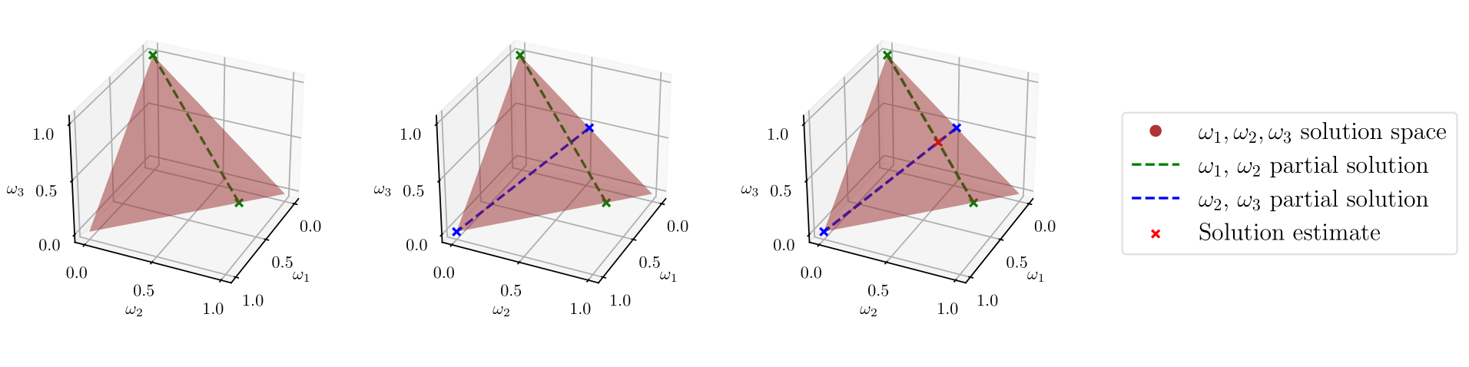
Multi-sensor Case
Sequential pair-wise linear solutions (partial solutions)
Repeat for all sequential pairs .
Intersection of linear partial solutions gives final estimate
Positive-definite covariances (positive traces) guarantee single solution

Slide 12
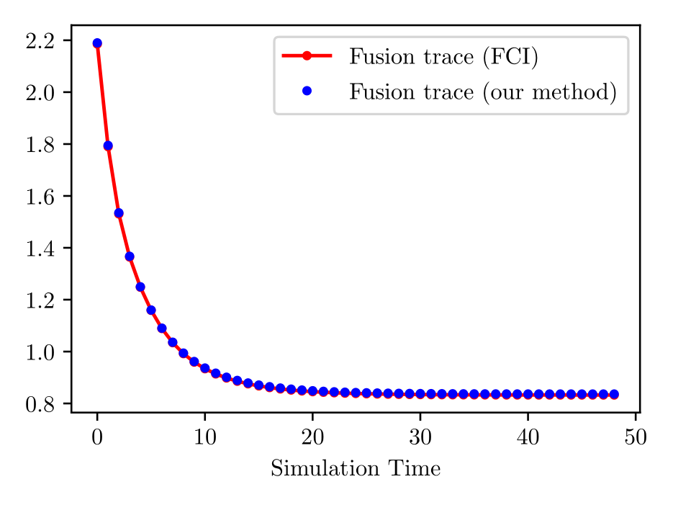
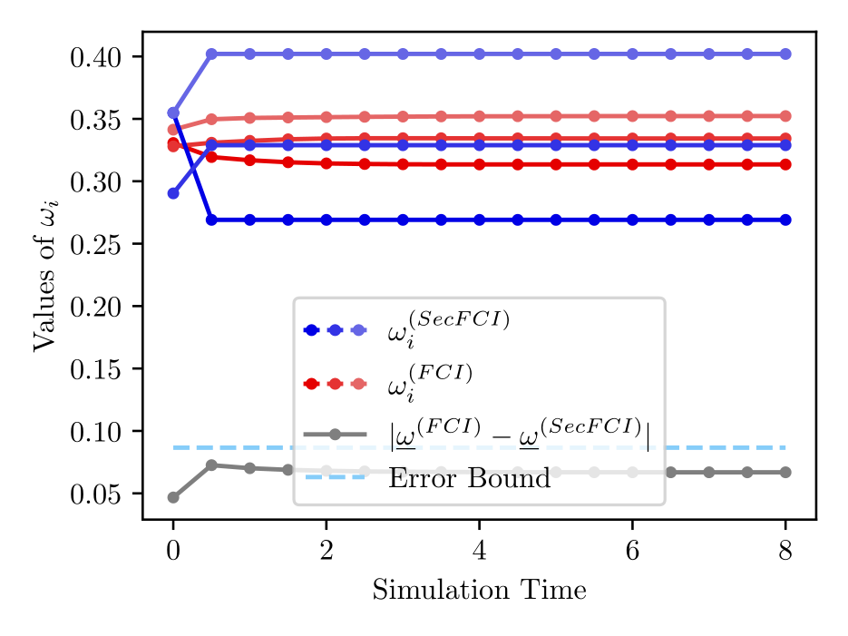
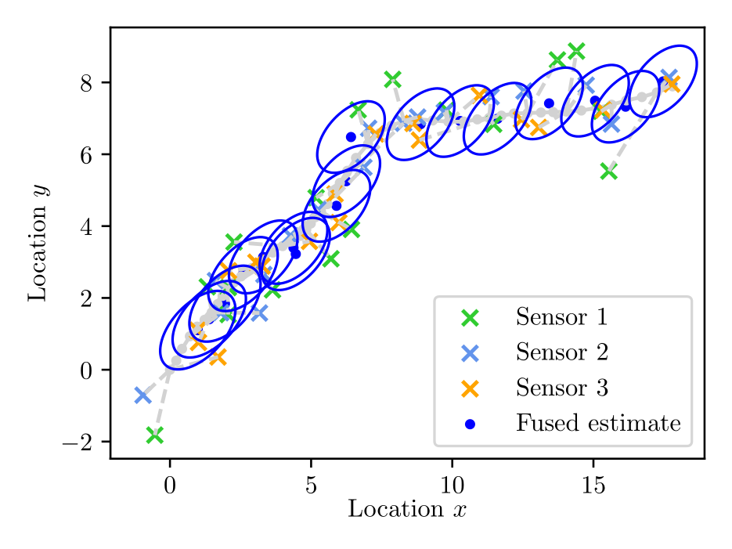
Simulation and Results
Fusion trace comparable to unencrypted method
Error between encrypted and unencrypted is strictly bounded

Slide 13
Conclusion and Outlook
Presented secure homomorphic FCI algorithm
Suitable for untrusted cloud providers or unsecure networks
Allows abstraction of sensor communication via third party
Shown to have bounded error
Future Work
Formalise leakage in terms of the encryption schemes used
Give real-time implementation comparison with FHE

Slide 14

Thank you – Questions

